Slide 1

Integrated Assignment on Synthetic Stock Data Analysis
Name : Nitesh Roll Number : A044161824008 Course : Masters’ in Data Science

Slide 2

This presentation offers a robust exploration of data analysis methodologies, from foundational techniques like Simple Random Sampling to advanced predictive tools like ARIMA models, including Hypothesis testing, Logistic Regression and Return Distribution Plotting.

Slide 3
Topics and techniques used
Sampling techniques
Log return plot
Inferential Statistics
Time Series
Logistic regression
Machine Learning

Slide 4
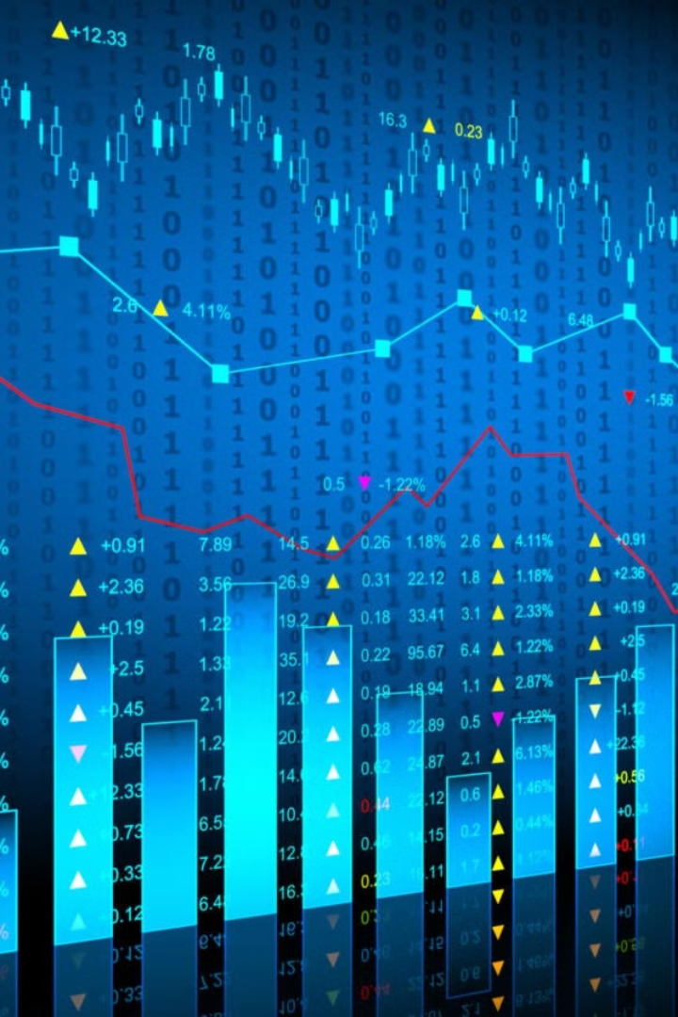
SIMPLE RANDOM SAMPLING WITHOUT REPLACEMENT
It's a way of selecting a random sample from a group (population) where:
Every individual has an equal chance of being chosen.
Once selected, that individual cannot be picked again.
Real-life examples:
Drawing lottery tickets.
Selecting survey participants from a list.
Picking random employees for a bonus review.

Slide 5
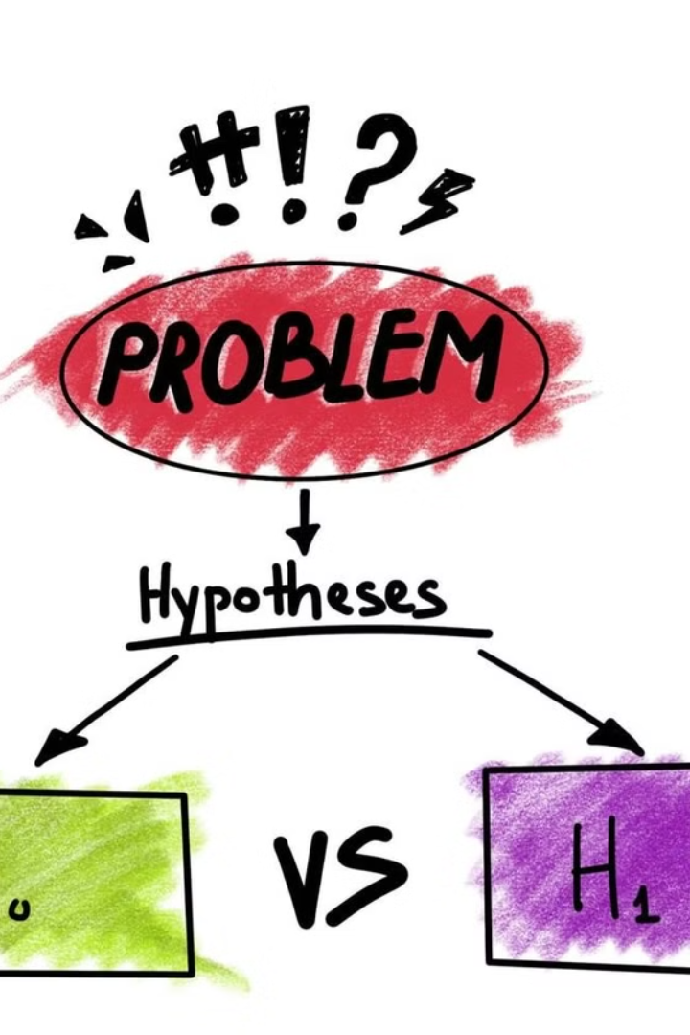
Hypothesis Testing
Hypothesis testing helps determine if there is enough evidence to reject a null hypothesis based on sample data. It's a critical part of inferential statistics, used to validate claims or assumptions.
1. One-Sample t-Test
H₀: Mean of Close = 100
H₁: Mean ≠ 100
Statistic: t-test
Distribution: Student’s t

Slide 6
2. Proportion z-Test (Gain Days)
H₀: Proportion of Close > Open = 0.5
H₁: Proportion ≠ 0.5
Statistic: z-test
Distribution: Normal (z)
3. F-Test (Variance Comparison)
H₀: Variance (Early) = Variance (Late)
H₁: Variances ≠
Statistic: F-test
Distribution: F-distribution

Slide 7
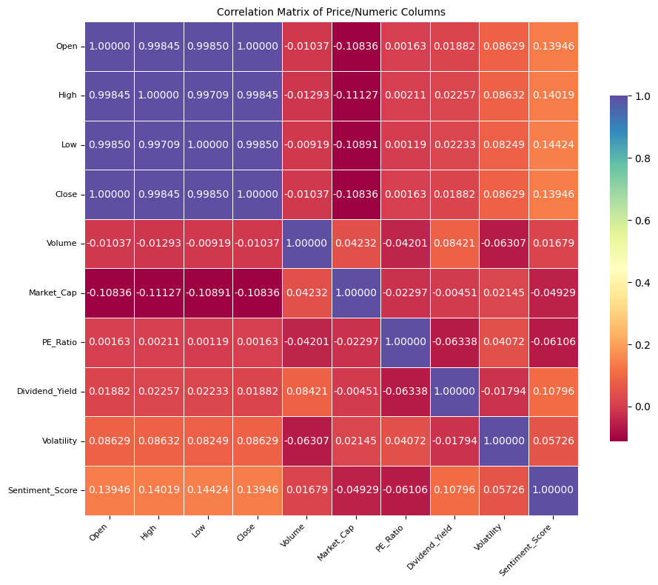
What is a Correlation Matrix?
A correlation matrix is a table showing correlation coefficients between many variables (features). Each cell in the table shows how strongly two variables are linearly related.
How Does It Work?
The matrix is symmetric (top right and bottom left are mirrors).
Values range from -1 to +1:
+1 = perfect positive correlation (they increase together)
-1 = perfect negative correlation (one increases, the other decreases)
0 = no linear correlation

Slide 8

🧠 What Logistic Regression Does
Logistic regression is a supervised machine learning algorithm used for classification tasks.
Here, it’s handling multiclass classification, meaning it predicts one of multiple possible categories (not just binary).
The model learns the relationship between input features (like prices, volume, sentiment) and the target trend.

Slide 9
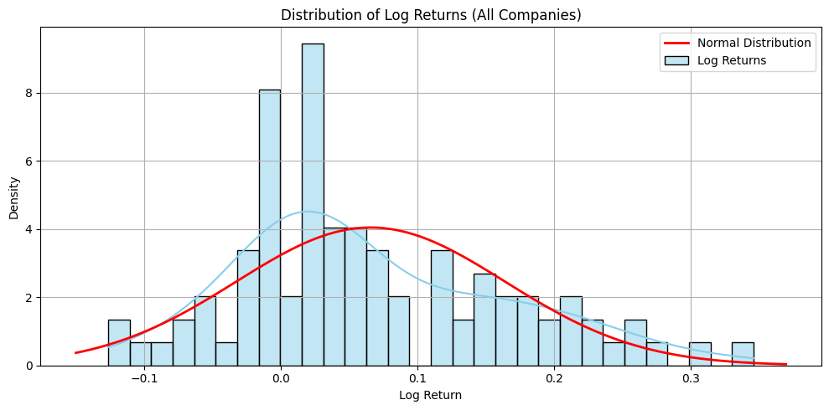
📈 Log Returns
Logarithmic returns are calculated as the log difference between today's and yesterday's close price.
These are preferred in finance because they are time-additive and often more normally distributed.

Slide 10
Descriptive Statistics Computed
Mean Return – The average log return, gives a sense of overall direction (positive or negative).
Standard Deviation – Measures volatility or how much returns deviate from the mean.
Skewness – Indicates asymmetry in the return distribution:
Positive skew = long right tail (more big gains).
Negative skew = long left tail (more big losses).
Kurtosis – Measures "tailedness":
High kurtosis = fat tails (more extreme returns).
Low kurtosis = thin tails.

Slide 11
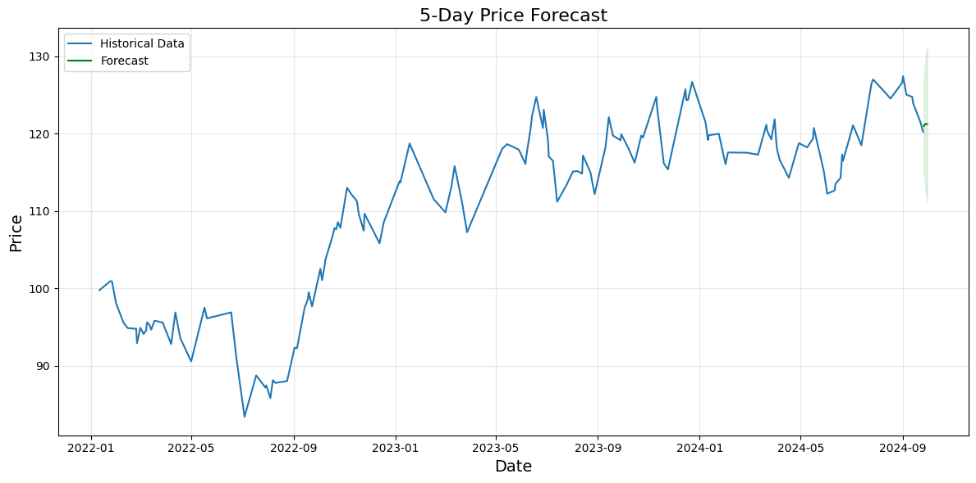
1. Time Series Preparation Focuses on the 'Close' price over time.
The data is sorted chronologically and indexed by date, making it ready for time series modeling.
2. ARIMA Modeling ARIMA (AutoRegressive Integrated Moving Average) is used to model the closing price.
The model captures patterns like trends and seasonality in the data.

Slide 12
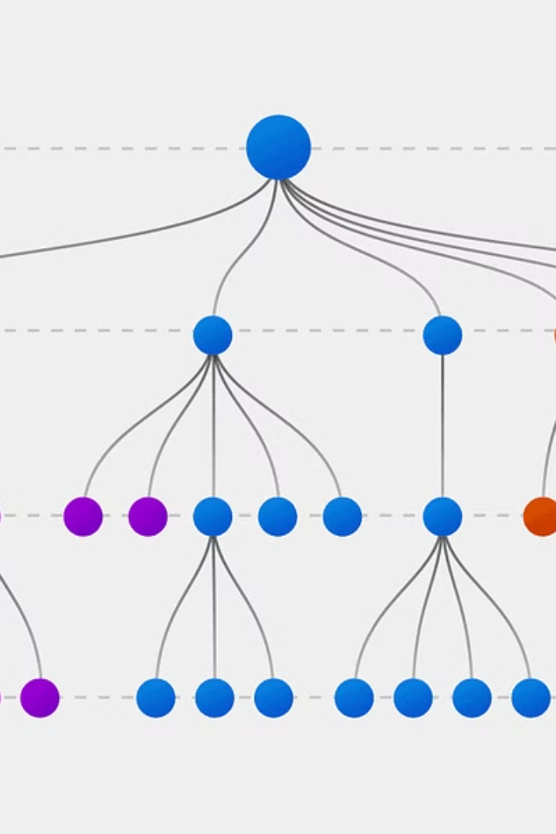
Decision Tree
A Decision Tree is a tree-like model that makes decisions by splitting data into branches based on feature values. Each node in the tree asks a question (e.g., “Is Volume > 1,000,000?”), and based on the answer, the data moves down the left or right branch until it reaches a leaf node, which gives the final prediction (e.g., "Trend = Up").

Slide 13

Example :
Imagine a decision tree trying to predict whether you should carry an umbrella:
🌧️ Is the forecast rainy?
Yes → Carry umbrella
No → Is it cloudy?
Yes → Maybe carry umbrella
No → Don’t carry umbrella

